Slide 1






Project Vlog #6
By The 4 Codesmen - Abraham, Dhruv, Dinesh, Favor
ENSE 400/477(2022-2023): SSE Capstone

Slide 2
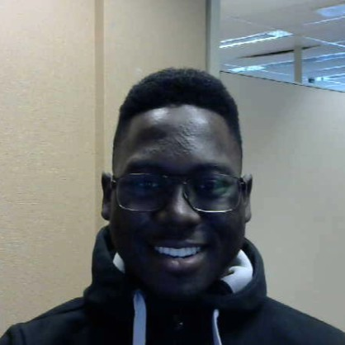
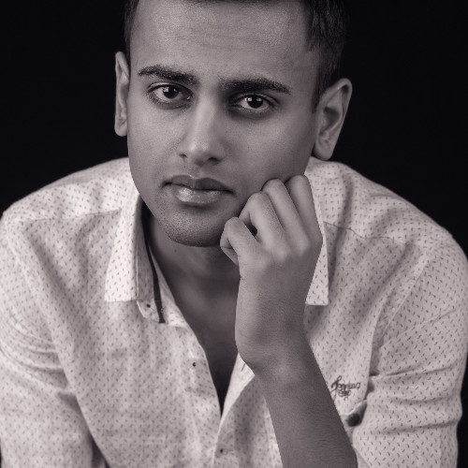
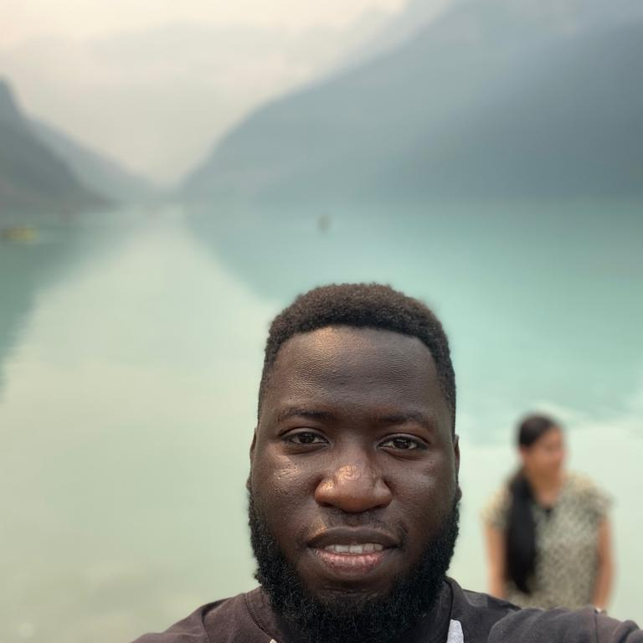
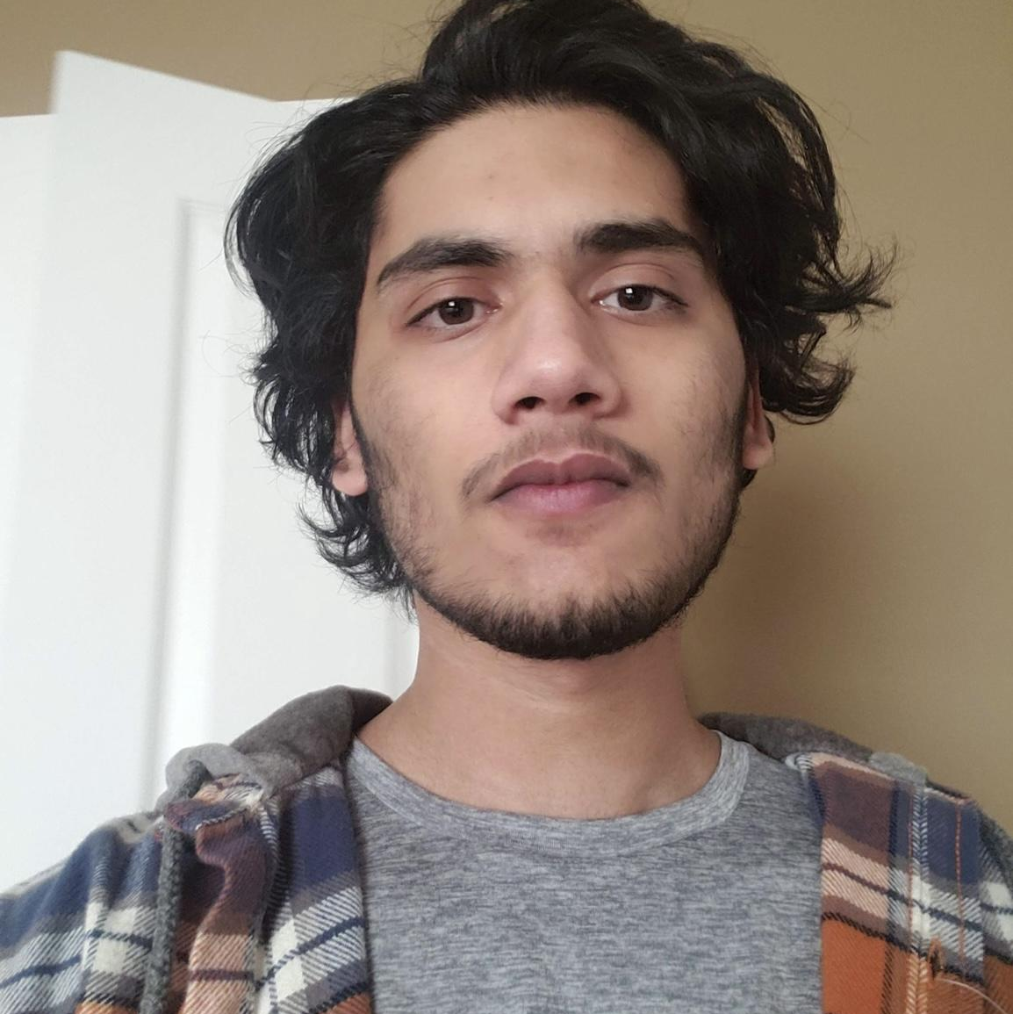
Team Members
Favor Fasunwon Full Stack Developer and UI/UX Designer
Dhruv Modi Team Lead and Full Stack Developer
Abraham Mugerwa Full Stack Developer and Documentation Manager
Dinesh Dalip Software Architect and Full Stack Developer

Slide 3



Project background & business need/opportunity
For our capstone project we are building a web application for UR residence that allows its tenants to:
Build a community (decrease social gap)
Take charge with the ability to report incidents
Stay up to date with events on residence
Live in an atmosphere that resembles home
Current Situation?
Only made for U of R at the moment
Opportunity?
Introduce this concept to other universities in Canada
Notes:
Current Situation
Currently U of R Residence does not have a dynamic application that brings U of R Students together. There is an application for U of R Residence however it is outdated and requires a major upgrade.
Opportunity
Build an application for U of R residence that
Replaces the old application
Enhances the experience of living on campus
Go beyond U of R and share this digital ecosystem with other University Residences as well.

Slide 4
Project/Work Activities
Mar.3, 2023 - Mar.17, 2023
Team: Met up with mentor, deployed the application, Conducted user testing and integration (manual) on the application, Ensure hosting site and food api is upgraded to paid version (restricting in rendered results).
Dhruv: Refactored Restaurants page with Favor (based off users feedback), finished the user testing report [only editing the document is left], and starting project commercial.
Abraham: Documented meeting minutes, and started working on the project experience report
Dinesh: Refactored and cleaned up the code base, started working on the code quality report.
Favor: Updated Kanban, Performed some CSS Customizations to chat, profile, login/signup, and complaint box (users can only see their complaints not everyones’) feature, started working on the code testing report.
P.S. Project poster in completed

Slide 5








PROJECT DEMO

Slide 6

Next Up
Kanban (https://github.com/orgs/The-4-Codesmen/projects/1/views/1)

Slide 7
Team Reflection
Does the team feel "on track"? (reiterate the above colour status)
Green Status. All features on the app is completed and tested.
What progress does the team particularly feel good (great) about?
The end app result is shown in high regard to those in residence (They loved it).
What barriers (if any) does the team feel are a current impediment to success?
The time constraint to effectively articulate the information from this entire app development process in form of reports. (Time is very tight to complete reports)
What help (if any) does the team require to move positively forward?
Confidence in our services working for project day.
What questions or concerns does the team have (if any)?
Just hoping integration testing can be accepted through manual processes rather than automation.

Slide 8

Thanks!
Any questions?
You can find me at:
fourcodesmen@gmail.com

Slide 9
Credits
Special thanks to all the people who made and released these awesome resources for free:
Presentation template by SlidesCarnival
Photographs by Unsplash

